Slide 1
Oracle ADF
8-Oct-2018
Nita Jain

Slide 2
Training Objective
After completing this training, you should be able to do the following:
Build and customize a data model by using ADF Business Components
Expose the data model in a Web application with a rich ADF Faces user interface
Secure Web applications

Slide 3
Prerequisites
Access to Oracle Jdeveloper 11g Version
Basics of Java language

Slide 4
What is Oracle ADF?
ADF is an end-to-end application framework that builds on Java Platform, Enterprise Edition (Java EE) standards and open-source technologies
Oracle ADF is used to implement enterprise solutions that search, display, create, modify, and validate data using web, wireless, desktop, or web services interfaces.

Slide 5
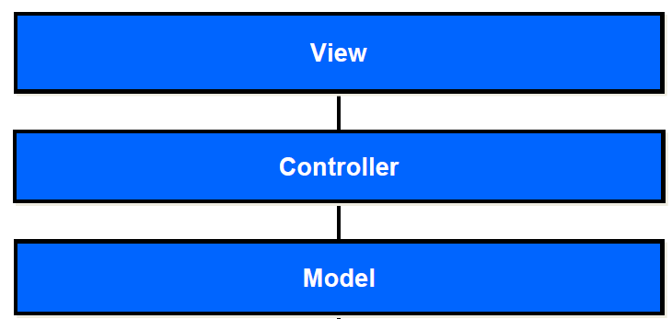
MVC Design Pattern

Slide 6
MVC Design Pattern
The Model-View-Controller (MVC) is an architectural pattern that separates an application into three main logical components: the model, the view, and the controller.
Each of these components are built to handle specific development aspects of an application.
MVC is one of the most frequently used industry-standard web development framework to create scalable and extensible projects.

Slide 7
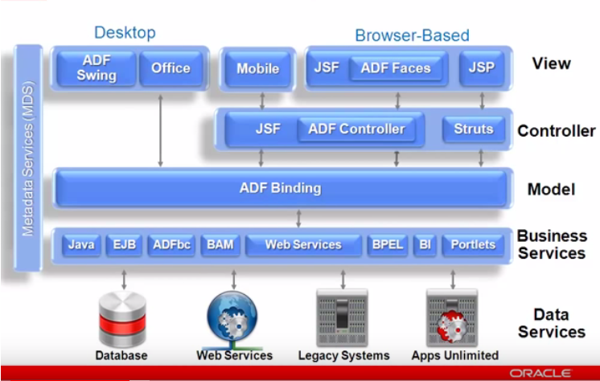
ADF Architecture

Slide 8
Getting Started with Jdeveloper

Slide 9
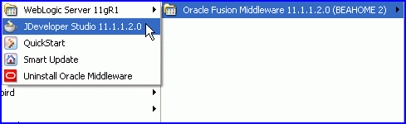
JDeveloper Launch
You can launch JDeveloper by:
Selecting
Start > Programs > Oracle Fusion Middleware 11.1.1.2.0 > JDeveloper Studio 11.1.1.2.0
Starting from the command line or a shortcut pointing to
jdev.exe in the <JDev Home>\jdev\bin directory

Slide 10
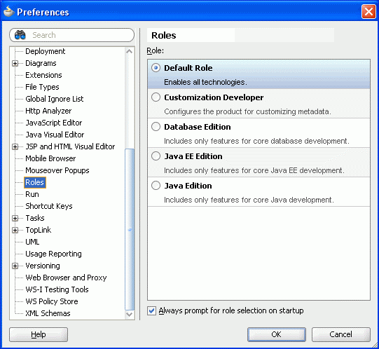
Defining Role
When you launch JDeveloper,
you need to select a developer role.
The JDeveloper environment
customizes itself based on the
role of the user.

Slide 11
Using JDeveloper Features
JDeveloper features that facilitate ease of application development include:
• Application Navigator
• Database Navigator
• Editor (code or visual editors)
• Component Palette
• Resource Palette (IDE and Application)
• Data Controls panel
• Structure Window
• Property Inspector
• Log Window

Slide 12
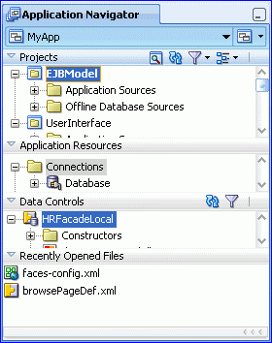
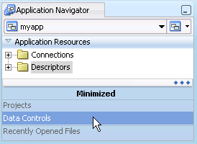

Using JDeveloper’s Application Navigator
Has expandable, minimizable panels to
display:
Projects
Application resources
Data controls
Recently opened files
Expandable panels
Minimizing a panel
Restoring a panel

Slide 13
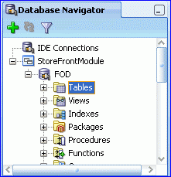
Using JDeveloper’s Database Navigator
The Database Navigator:
Shows both IDE and application connections
Enables you to:
– View database elements – Delete connections
– Filter the display – Change connection properties
– Create new connections – Open SQL Worksheet

Slide 14
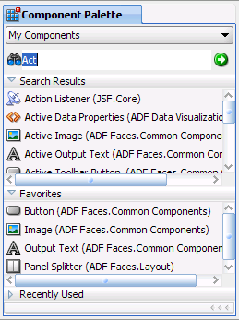
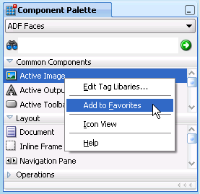
Using JDeveloper’s Component Palette
The Component Palette enables you to:
• Display the components available to drag to visual editor
• Search for components
• Display the favorites and recently used components

Slide 15
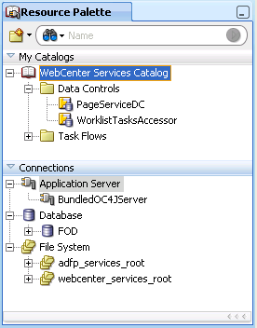
Using JDeveloper’s Resource Palette
The Resource Palette:
Contains two types of resources:
– Catalogs
– Connections
Provides single searchable view
of and access to many types of
resources
Facilitates sharing resources
among developers

Slide 16
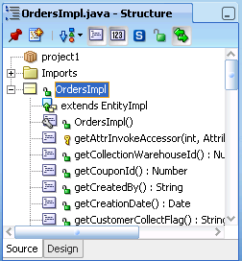
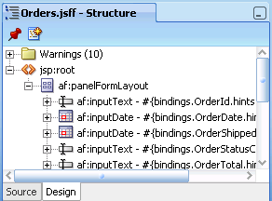
Using JDeveloper’s Structure Window
The Structure Window provides:
• A tree view of the selected document or object
• The ability to:
– View in different ways
– Navigate

Slide 17
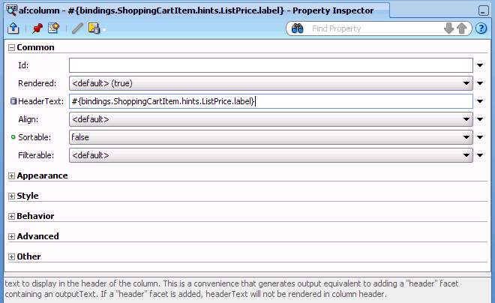
Using JDeveloper’s Property Inspector
The Property Inspector presents a collection of all settable properties for a selected element.

Slide 18
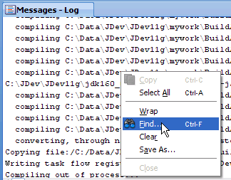
Using JDeveloper’s Log Window
The Log window:
• Displays Jdeveloper messages, such as
logging and compilation messages
• Has one or more tabs:
a Messages tab and additional
tabs depending on what is occurring
• Displays standard output (such as
System.out.println() messages)
• Has context menu for clearing, wrapping, saving output,
searching, and so on

Slide 19
References
Oracle ADF Developer Guide
http://docs.oracle.com/cd/E28280_01/web.1111/b31974/toc.htm
Oracle ADF Code Corner
http://www.oracle.com/technetwork/developer-tools/adf/learnmore/index-101235.html
Oracle ADF Certification Details
https://education.oracle.com/pls/web_prod-plq-dad/db_pages.getpage?page_id=5001&get_params=p_exam_id:1Z0-554

